Slide 1
Animal Image Classification
Modular Deep Learning with ResNet18, Captum & Dual UI Deployment
Harsh Sharma https://github.com/HarshSharma0007/ml-internship

Slide 2
Project Tech Stack
Type | Tools / Libraries
Language | Python 3.10+
Frameworks | PyTorch (ResNet18), TorchVision
Explainability | Captum (IG, Saliency), Matplotlib
Image Handling | Pillow, OpenCV, Albumentations
UI/UX | Streamlit, Gradio
Data Utils | scikit-learn, Pandas, Pillow
DevOps | Git, Github
Tracking | MLflow, CSV summaries
Deployment | Gradio share link or Streamlit local app

Slide 3
Overview
🔍 Objective: Build a full-stack DL pipeline for multi-class animal classification
📦 Classes: 15 animals including Tiger, Panda, Dog, Elephant, etc.
📈 Accuracy: 93.15%
🧠 Explainability: Captum (Integrated Gradients & Saliency Maps)
🖥️ Deployment: Streamlit (local dashboard) & Gradio (hosted demo)
🧱 Design: Modular codebase for training, inference, and UI

Slide 4
Model Architecture
Transfer Learning : ResNet18 (pretrained on ImageNet)
Final Layer: Adapted to 15-class softmax
Training: 20 epochs, 224×224 input size
Optimizer: Adam | Loss: CrossEntropy | Scheduler: StepLR
Saved Model: resnet18_20250702_155546.pt

Slide 5
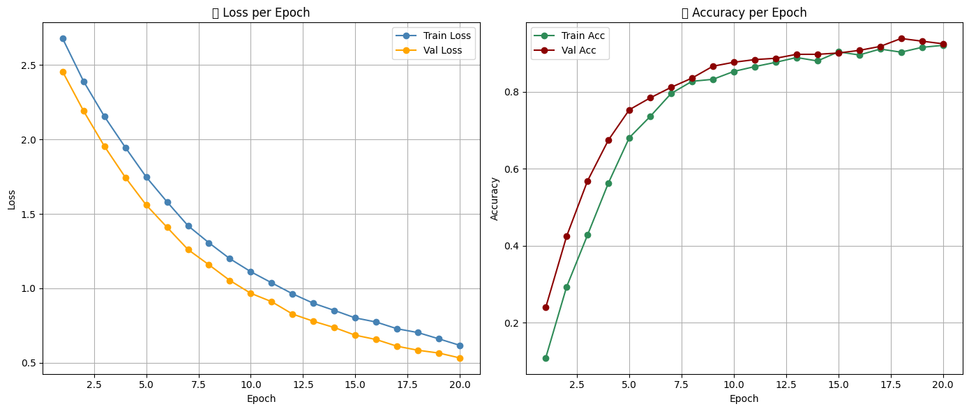

Slide 6
Data Pipeline
├── data/
│ ├── raw/ # Original dataset (class-wise folders)
│ ├── processed/ # Train / Val / Test splits after stratification
│ │ ├── test/
│ │ ├── train/
│ │ └── val/
│ └── splits/ # CSVs tracking split assignments
│
├── models/ # Saved model weights (.pt)
│
├── notebooks/
│ ├── 01_data_split_and_explore.ipynb # Stratified split + distribution plots
│ ├── 02_dataloader_test.ipynb
│ ├── 03_train_in_notebook.ipynb
│ ├── 04_evaluate_model.ipynb
│ ├── 05_project_summary.ipynb
│ ├── 06_two_models_evaluation.ipynb
│ └── 07_captum_explainability.ipynb
│
├── reports/
│ ├── explainability/ # Captum Attribution images per class
│ ├── Model1/ # Model with high accuracy
│ ├── metrics.txt
│ ├── per_class_metrics.csv
│ └── class_distribution_summary.csv # Count of images per class per split
│ ├── metrics.txt
│ ├── per_class_metrics.csv
│ └── class_distribution_summary.csv # Count of images per class per split
│
├── src/
│ ├── interpret/
│ └── captum_visualizer.py
│ ├── models/
│ ├── effnet.py
│ └── resnet.py
│ ├── utils/
│ └── helpers.py
│ ├── init.py
│ ├── config.py
│ ├── dataloader.py
│ ├── ensemble.py
│ ├── evaluate.py
│ ├── inference.py
│ └── train.py
│
├── streamlit_app/
│ ├── assets/
│ └── sample_images/
│ ├── models/
│ ├── utils/
│ ├── inference.py # Prediction wrapper
│ └── captum_utils.py # Attribution backend
│ ├── Home.py # Streamlit UI
│ └── requirements.txt
│
├── gradio_app/
│ ├── examples/
│ └── sample_images/
│ ├── models/
│ ├── utils/
│ └── infer_example.py # Gradio backend interface
│ └── app.py # Gradio frontend launcher
│
├── requirements.lock
├── requirements.txt
└── README.md
📊 Stratified Splitting: Balanced train/val/test sets
🧪 Augmentation: Albumentations for robustness
📁 Tracking: CSV summaries + MLflow logs
📂 Structure:
- raw/ → processed/ → splits/
- notebooks/ → reports/ → src/

Slide 7
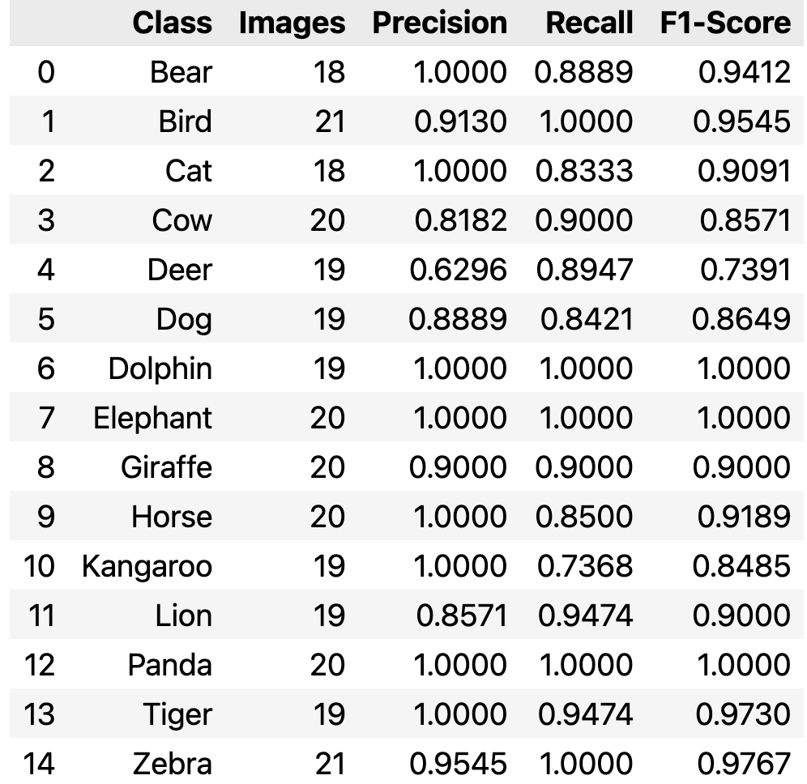
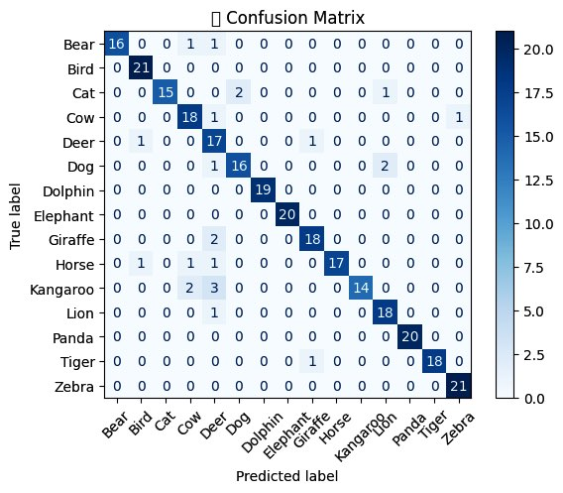
Per-Class Evaluation Metrics

Slide 8
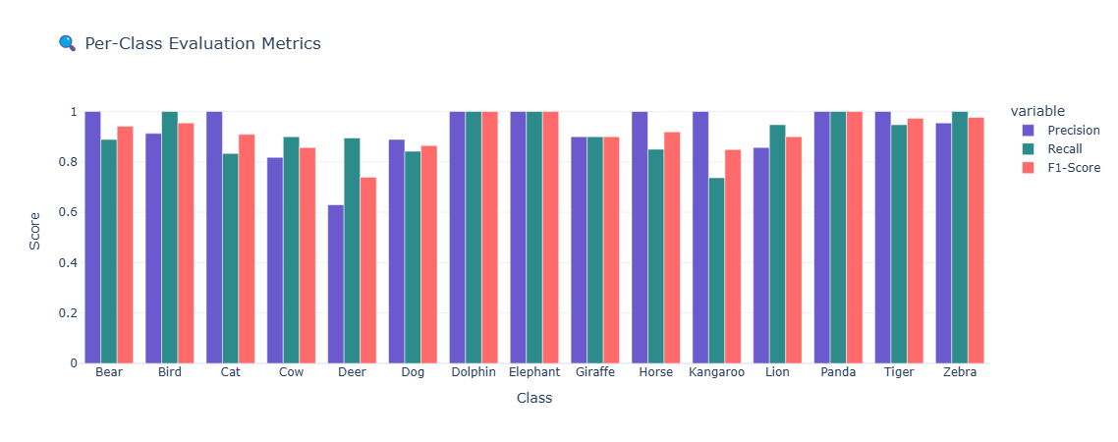
Per-Class Evaluation Metrics

Slide 9
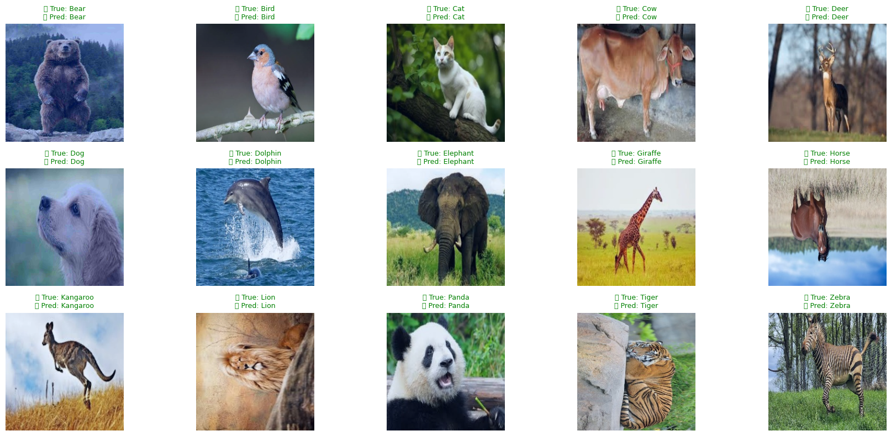
Prediction On the Test Dataset

Slide 10
Explainability with Captum
🧠 Captum Integration:
- Integrated Gradients: Smooth, interpretable
- Saliency Maps: Fast, gradient-based
📁 Code: captum_visualizer.py + plot_attributions()
📂 Outputs: Attribution maps per class in reports/explainability/

Slide 11
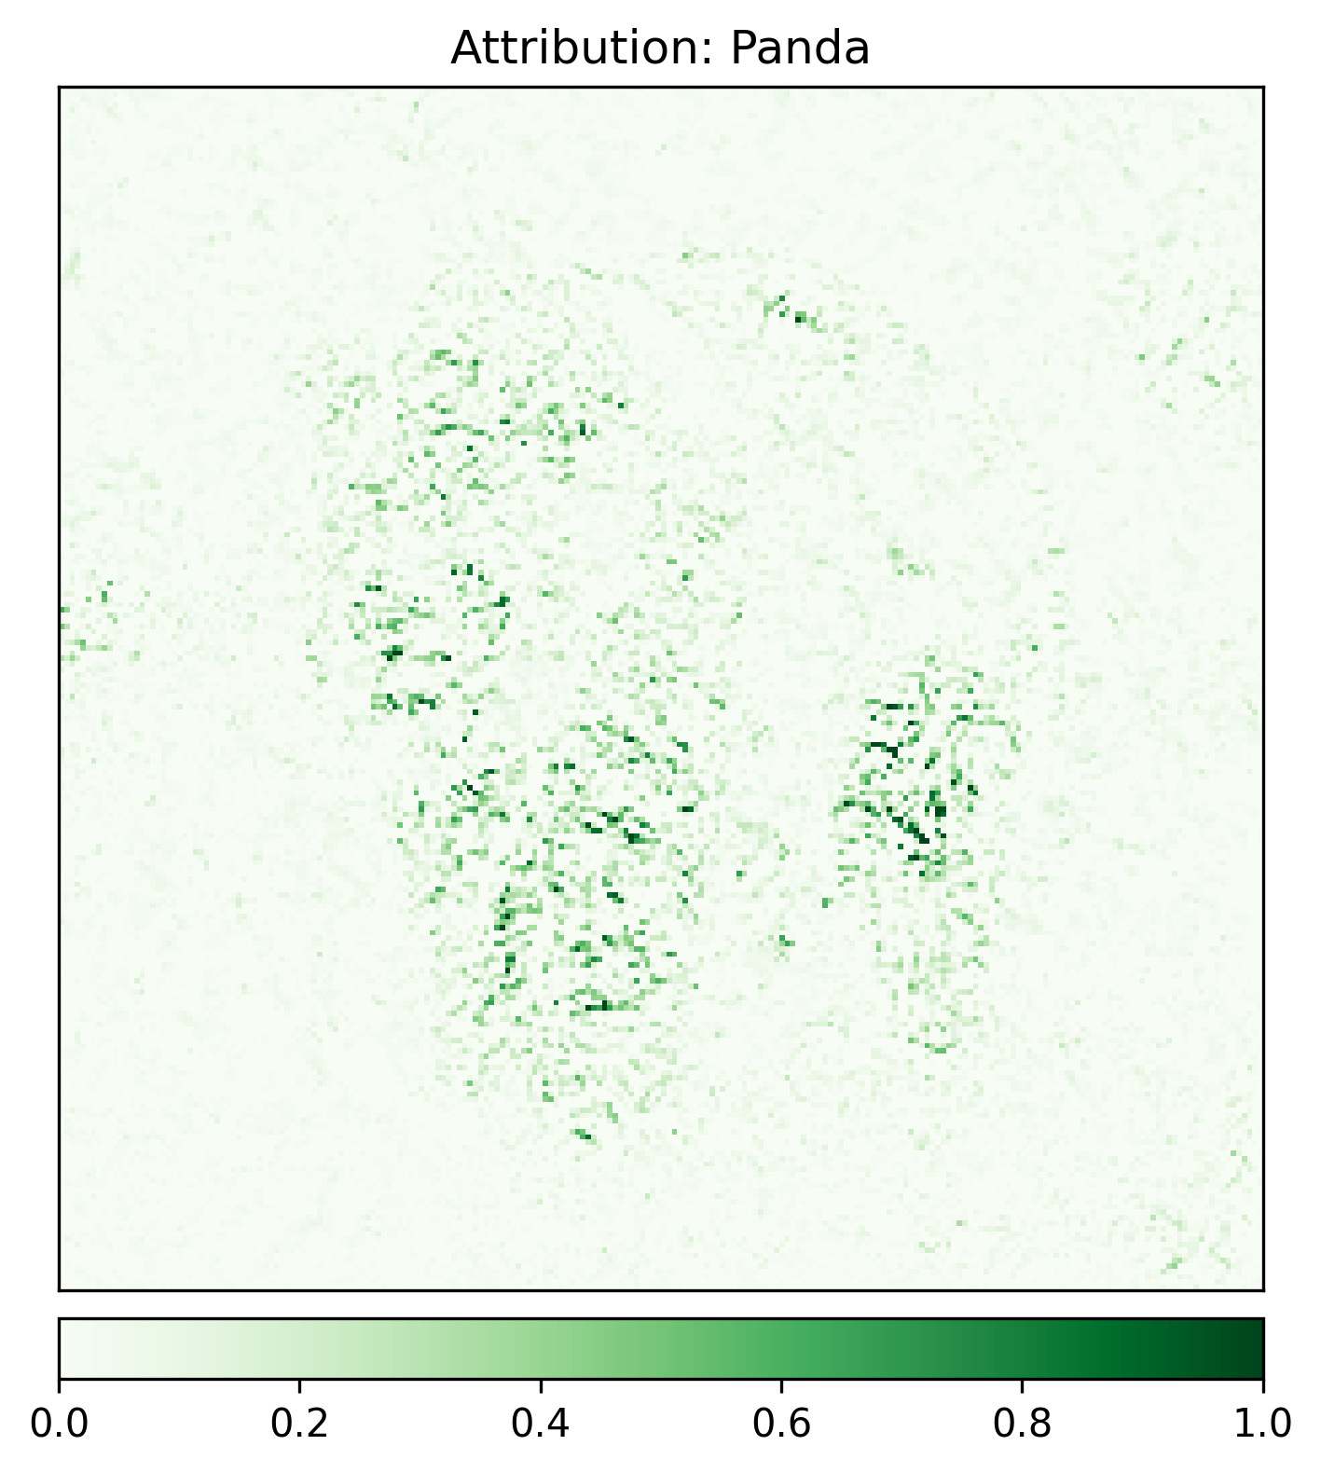
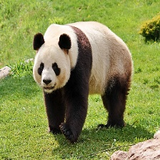

Slide 12
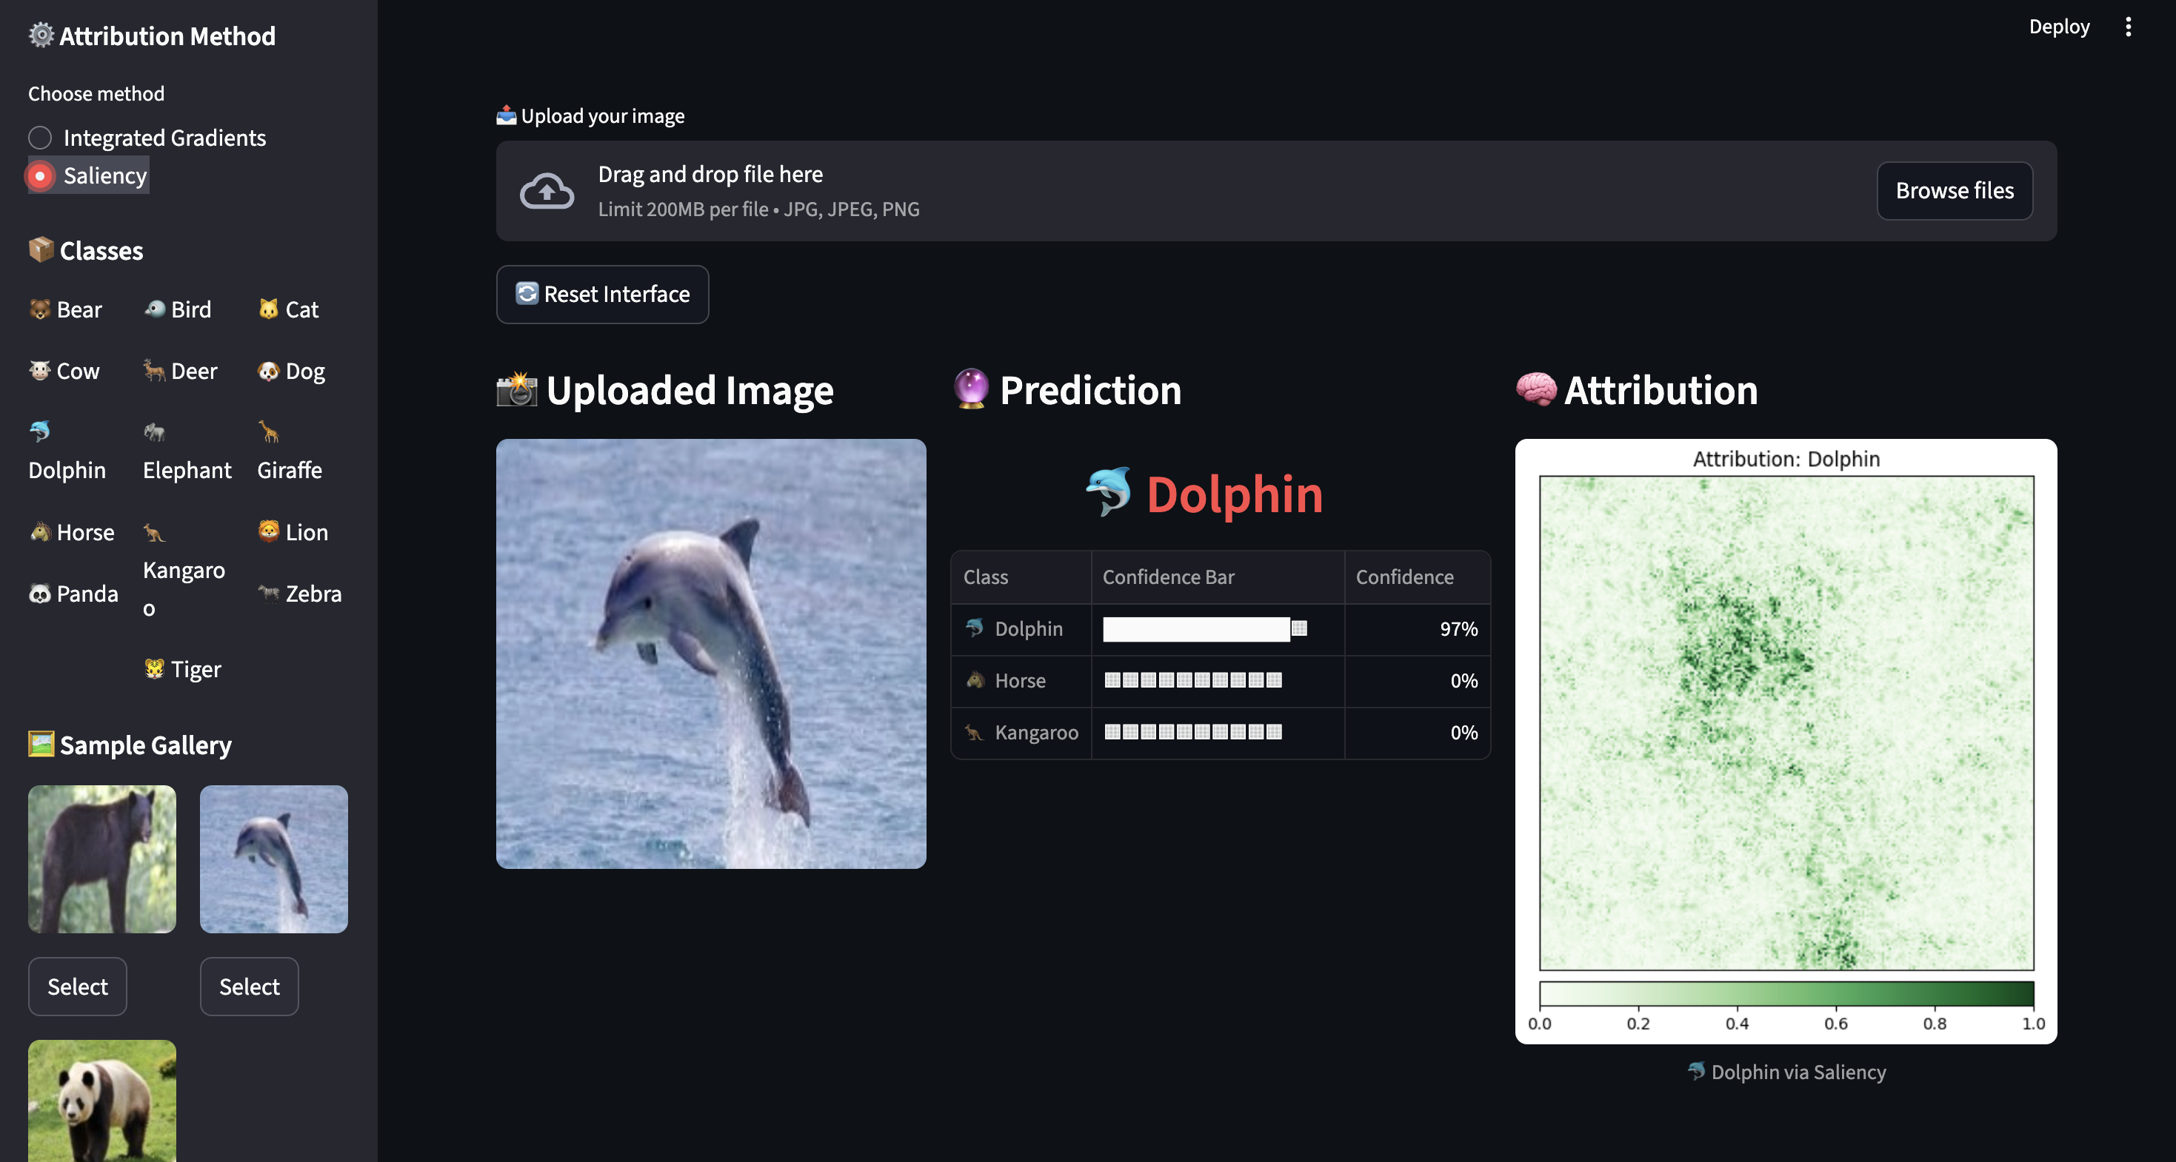
Streamlit Dashboard

Slide 13
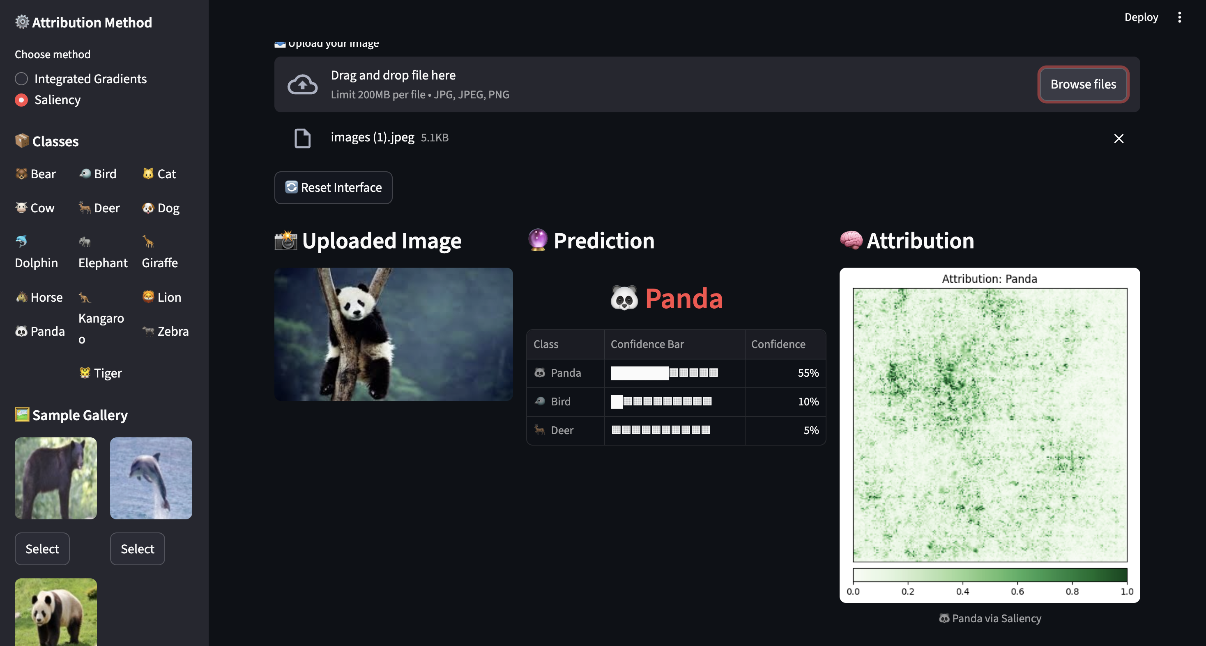

Slide 14
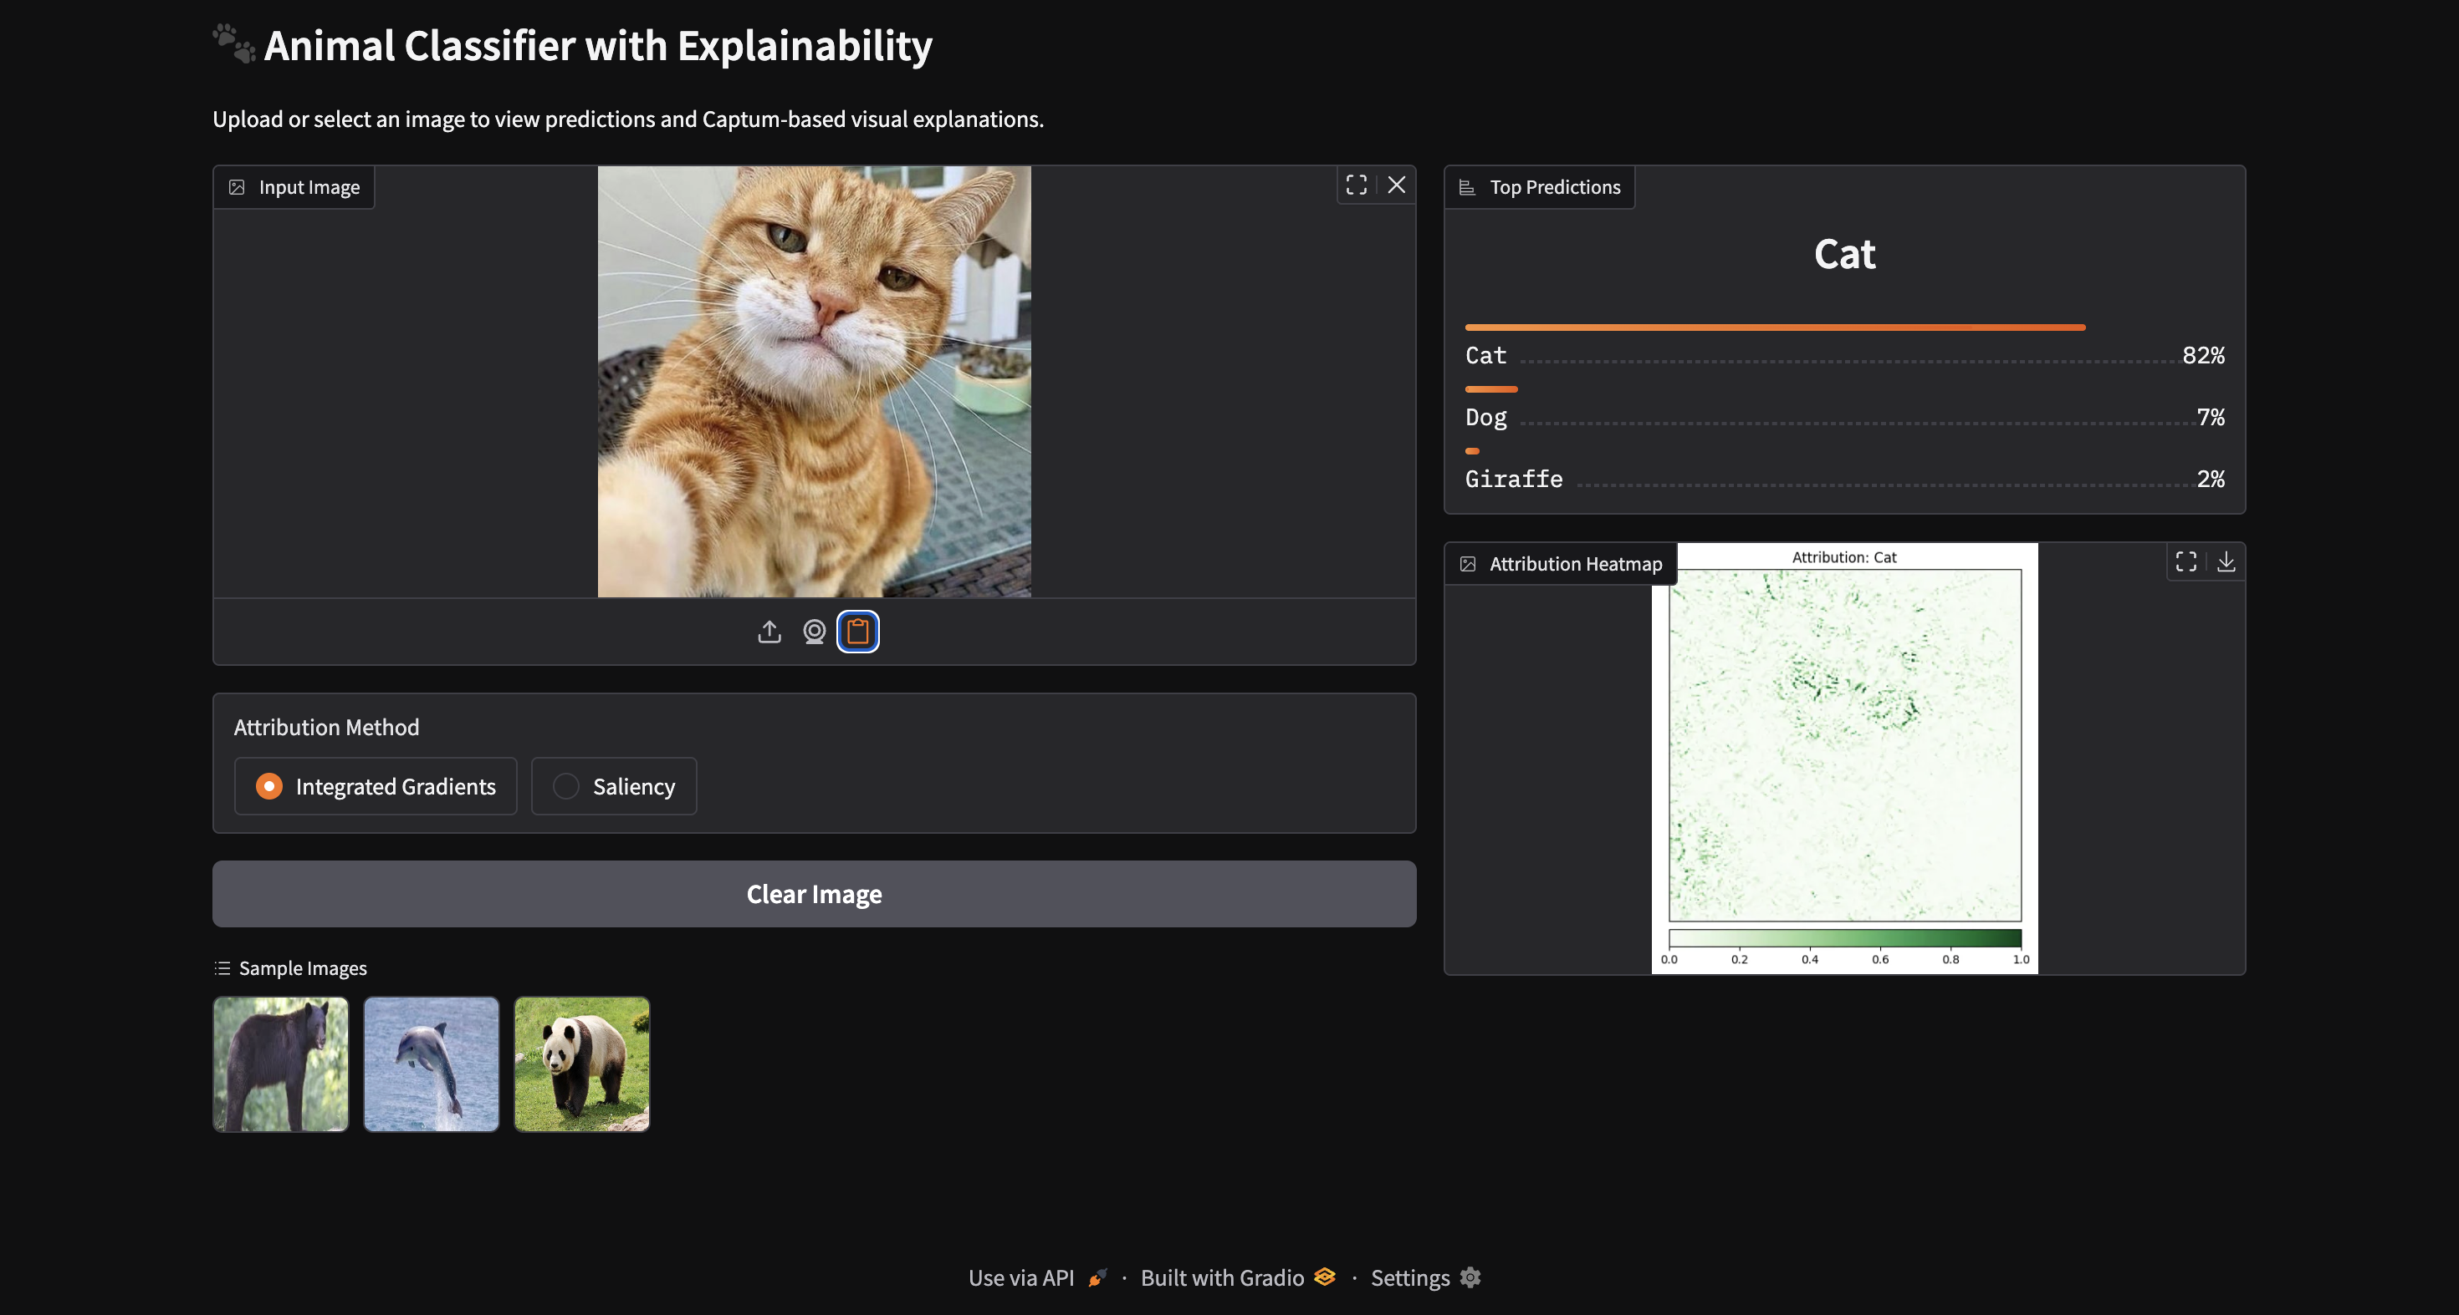
Gradio Interface

Slide 15
Modular Codebase
🧱 Modular Design:
- Decoupled train/test/infer pipelines
- Reusable components for UI and backend
📁 Key Files: `train.py`, `evaluate.py`, `ensemble.py`, `inference.py` `captum_visualizer.py`, `helpers.py`
🎯 Benefits: Clarity, scalability, teaching-friendly

Slide 16
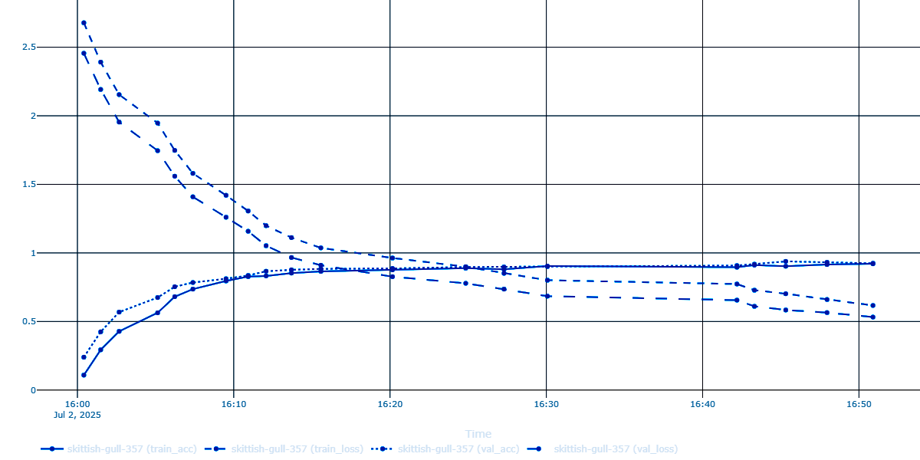
MLflow & Experiment Tracking
train_acc-train_loss-val_acc-val_loss

Slide 17
Deployment & Access
📦 Streamlit Launch:
cd streamlit_app
streamlit run Home.py
🌐 Gradio Launch:
python app.py
🏆 Achievements:
- 93.15% accuracy
- Dual UI deployment
- Explainability-first design
📚 Learnings:
- Captum integration challenges
- UI/UX for ML apps
- Importance of modularity & stratified splits

Slide 18
Thank You

Slide 19
Heart Disease Prediction
Modular, Interpretable ML for Clinical Decision Support
ML Pipeline with Streamlit & Tableau
Harsh Sharma https://github.com/HarshSharma0007/ml-internship

Slide 20
Project Objective
🎯 Goal:
Predict heart disease using patient vitals.
Build a reproducible, interpretable ML pipeline.
Deploy as a demo-ready app for clinical and educational use.
🧱 Design Principles:
Modular codebase
Clinically relevant features
Ethical modeling with low false negatives

Slide 21
Dataset Overview
📦 Dataset:
303 anonymized patient records
13 features + binary target
No missing values
🔍 Key Features:
Age, Sex, Chest Pain Type
Cholesterol, ECG, Max Heart Rate
Exercise-induced angina, ST depression

Slide 22
Workflow Summary
ML Pipeline:
1. EDA: Distribution plots, correlation matrix
2. Preprocessing: Scaling, encoding, SMOTE
3. Modeling: Logistic Regression → Random Forest
4. Optimization: Threshold tuning, feature importance
5. Deployment: Streamlit app with clinical UX

Slide 23
Feature Importance
🔍 Top Features:
- Chest Pain Type
- Max Heart Rate
- ST Depression
- Resting ECG
📚 Clinical Insight:
- Aligns with known cardiac risk factors
- Supports explainable decision-making

Slide 24
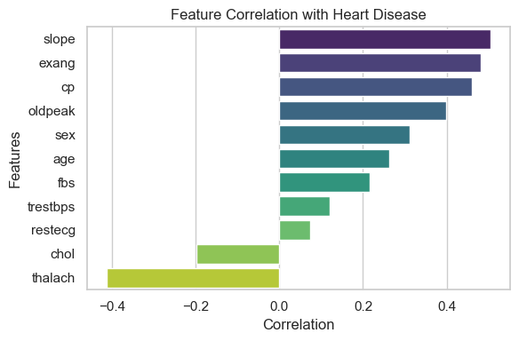
Feature Importance

Slide 25
Final Model Performance
📊 Final Model: Random Forest + SMOTE + Threshold = 0.4
✅ Accuracy: 95%
✅ Precision: 94%
✅ Recall: 98%
✅ F1 Score: 96%
✅ ROC AUC: 97%
❗ False Negatives: 3 out of 238
📌 Interpretation: High recall ensures clinical safety

Slide 26
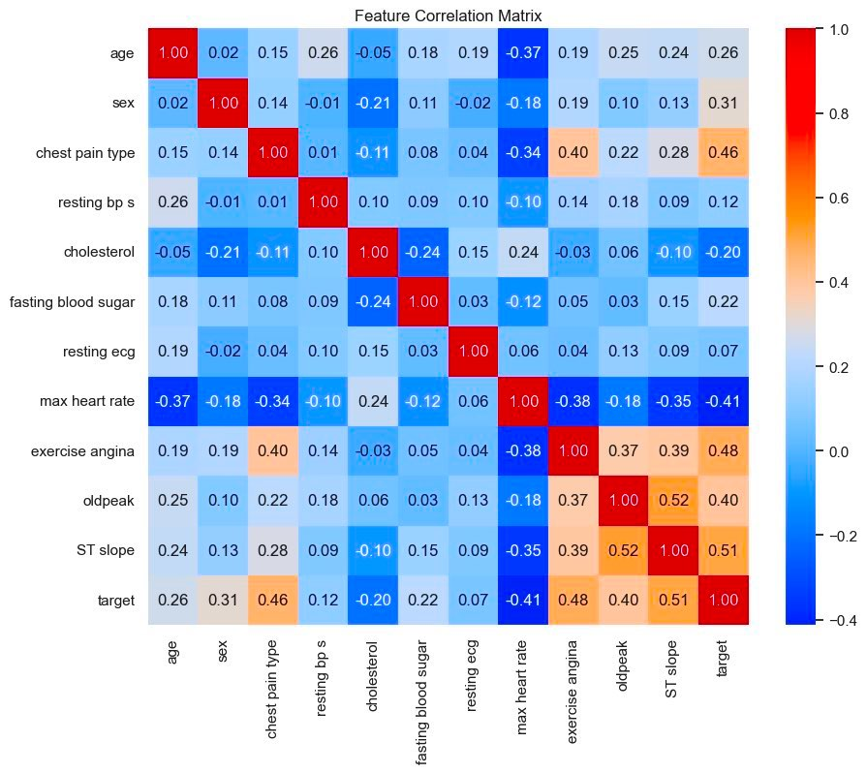

Slide 27
Threshold Tuning
🎯 Why Tune Threshold?
- Default (0.5) missed critical cases
- Tuned to 0.4 for higher recall
Outcome:
- Reduced false negatives
- Improved clinical reliability

Slide 28
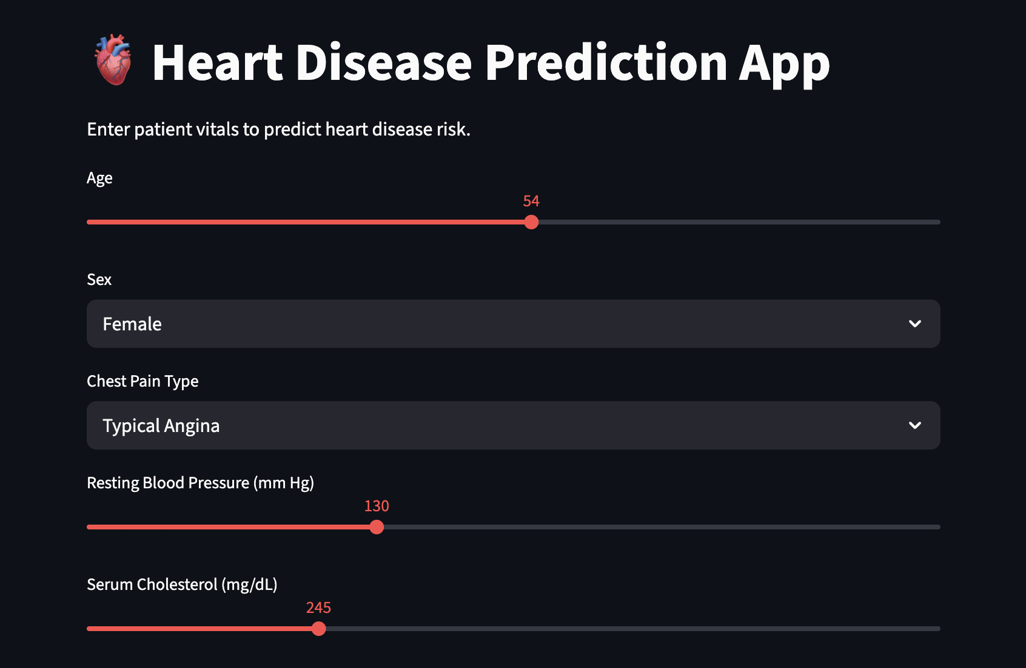
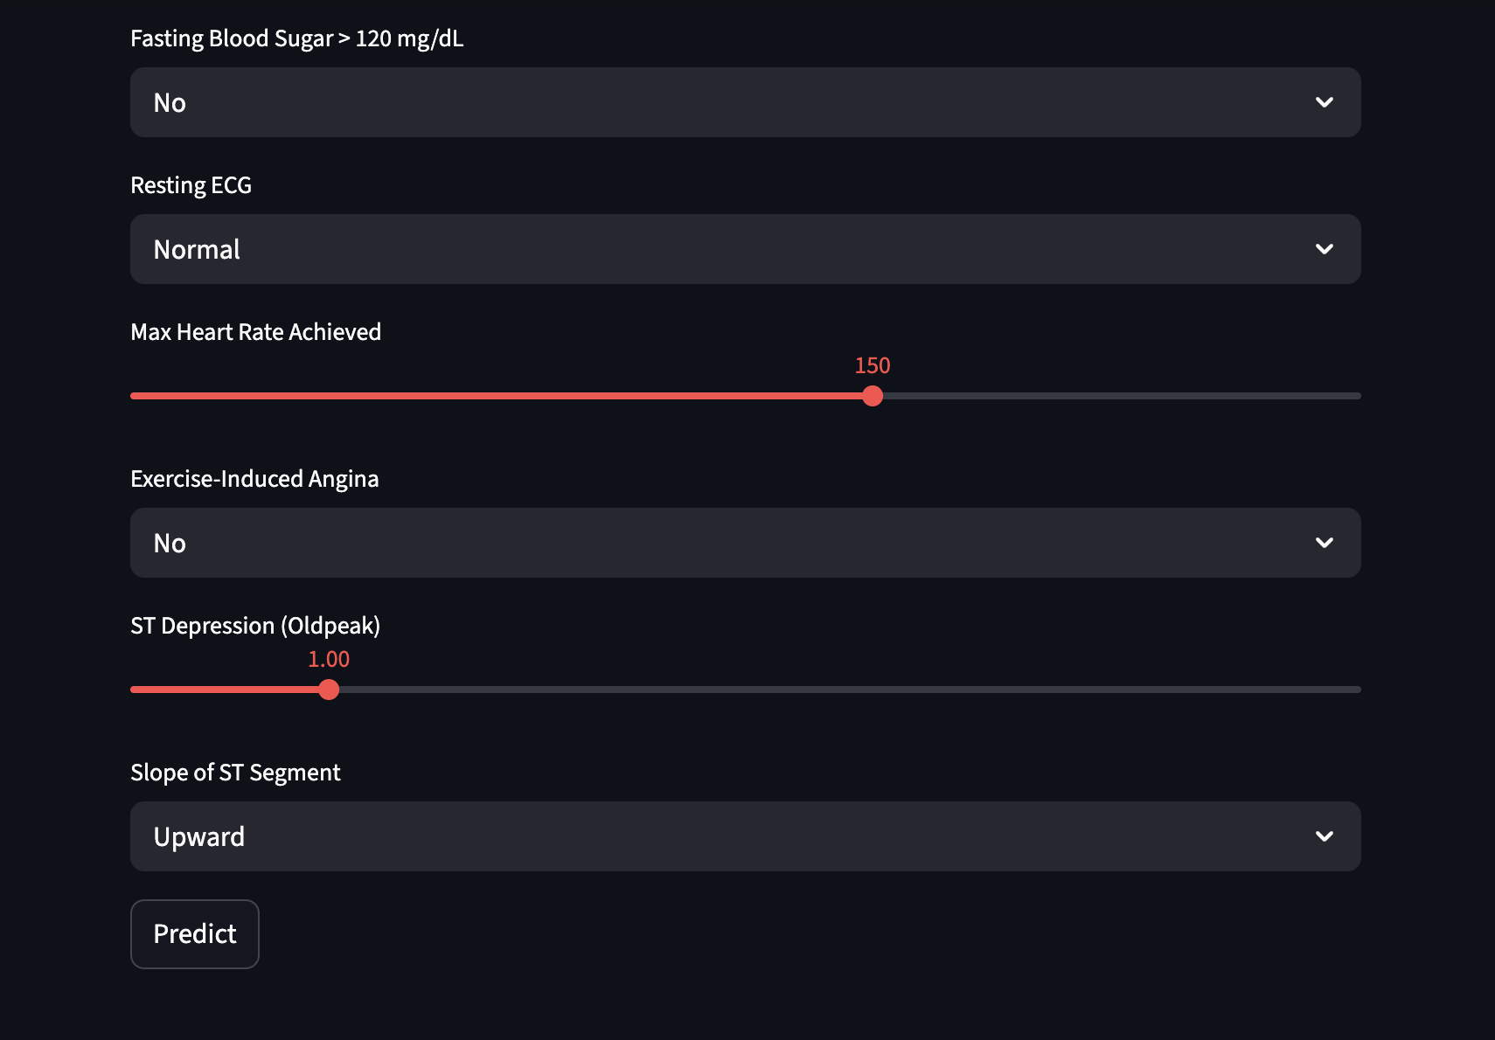
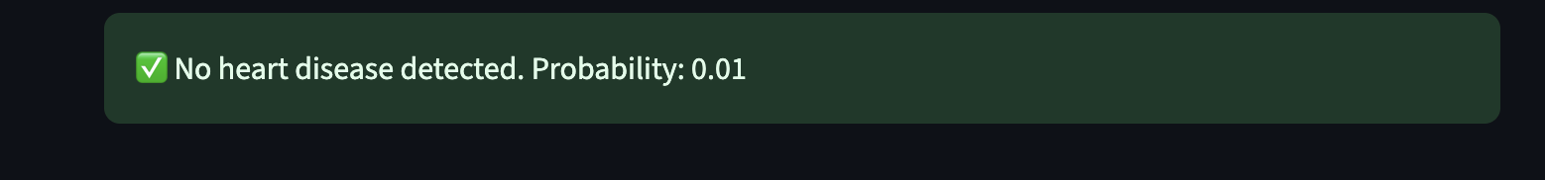
Streamlit App Demo
🚀 App Features:
- Sliders for vitals (e.g., age, cholesterol)
- Dropdowns for categorical inputs
- Real-time prediction with probability
- Clinical terminology for accessibility
📁 Code: `app.py`, `predict.py`, `preprocess.py`

Slide 29
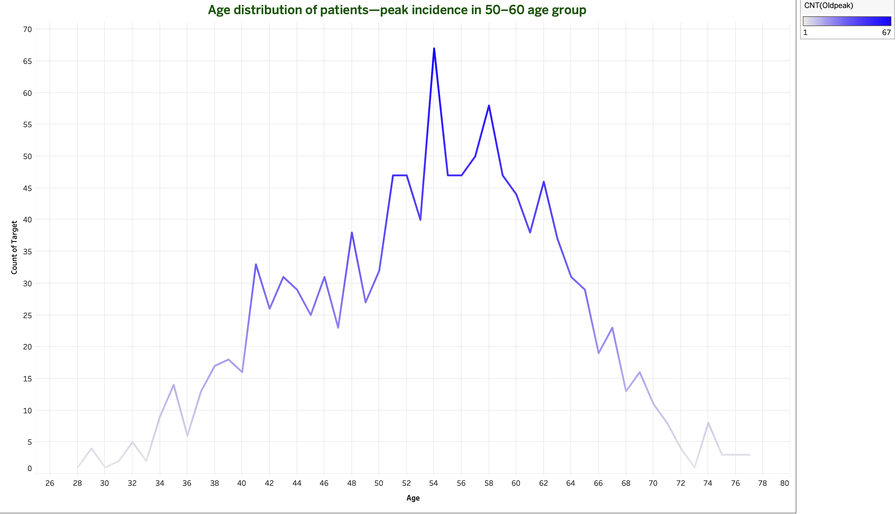
Visualisation & Tableau Integration

Slide 30
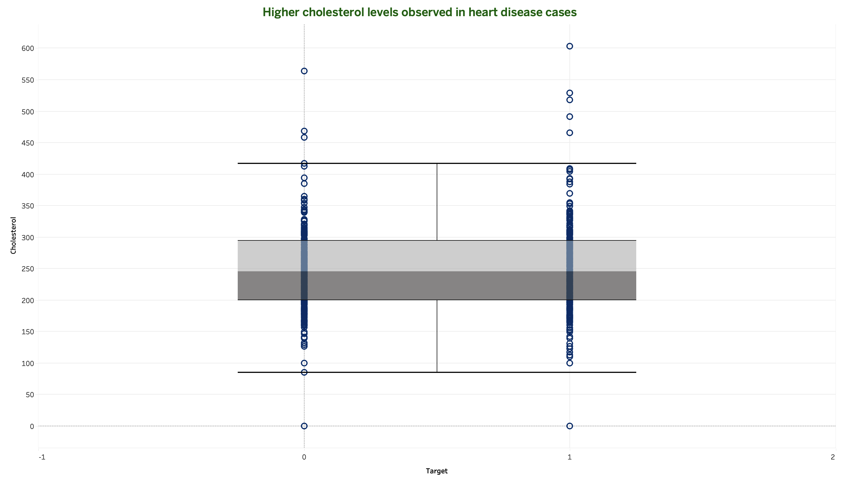
Visualisation & Tableau Integration

Slide 31
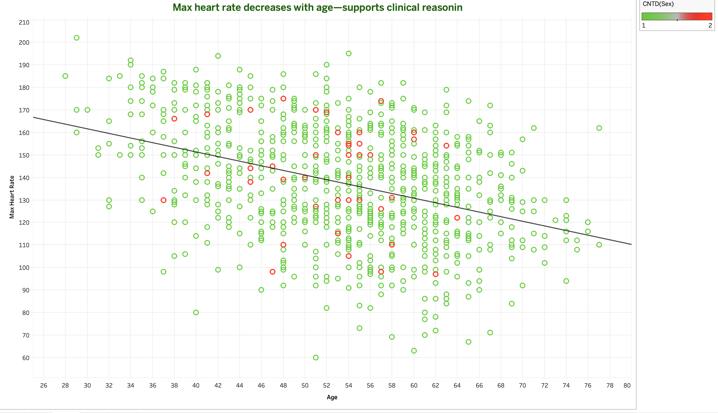
Visualisation & Tableau Integration

Slide 32
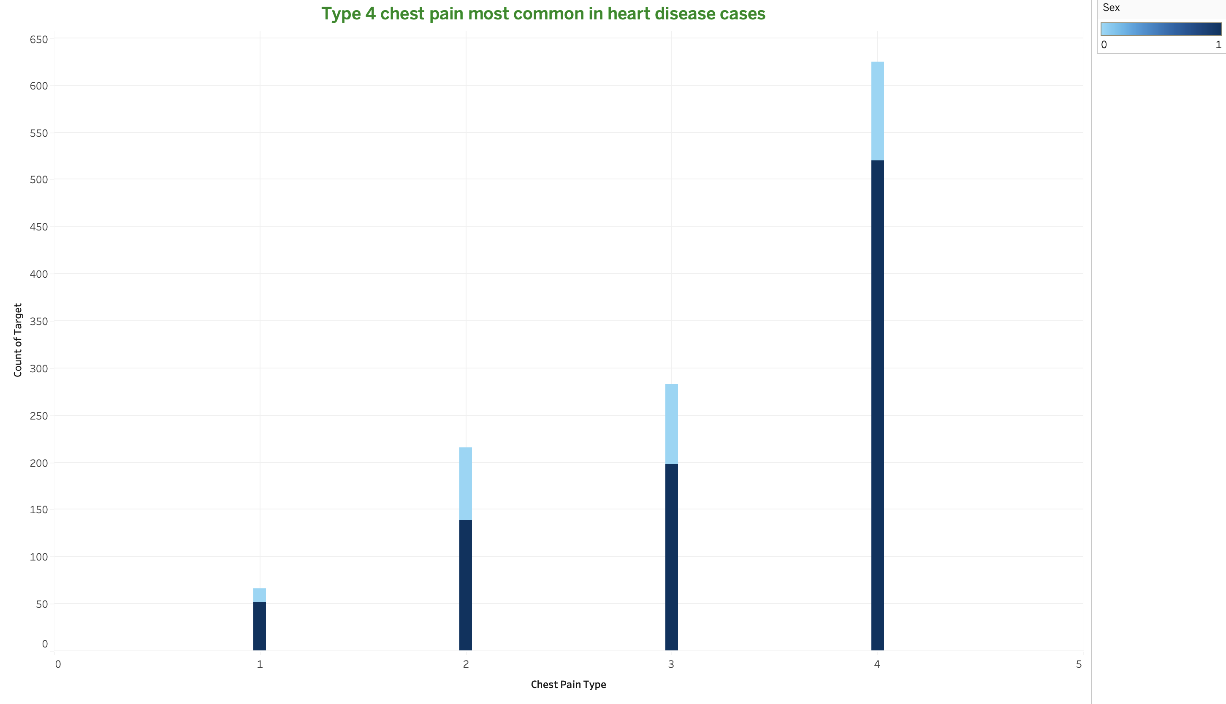
Visualisation & Tableau Integration

Slide 33
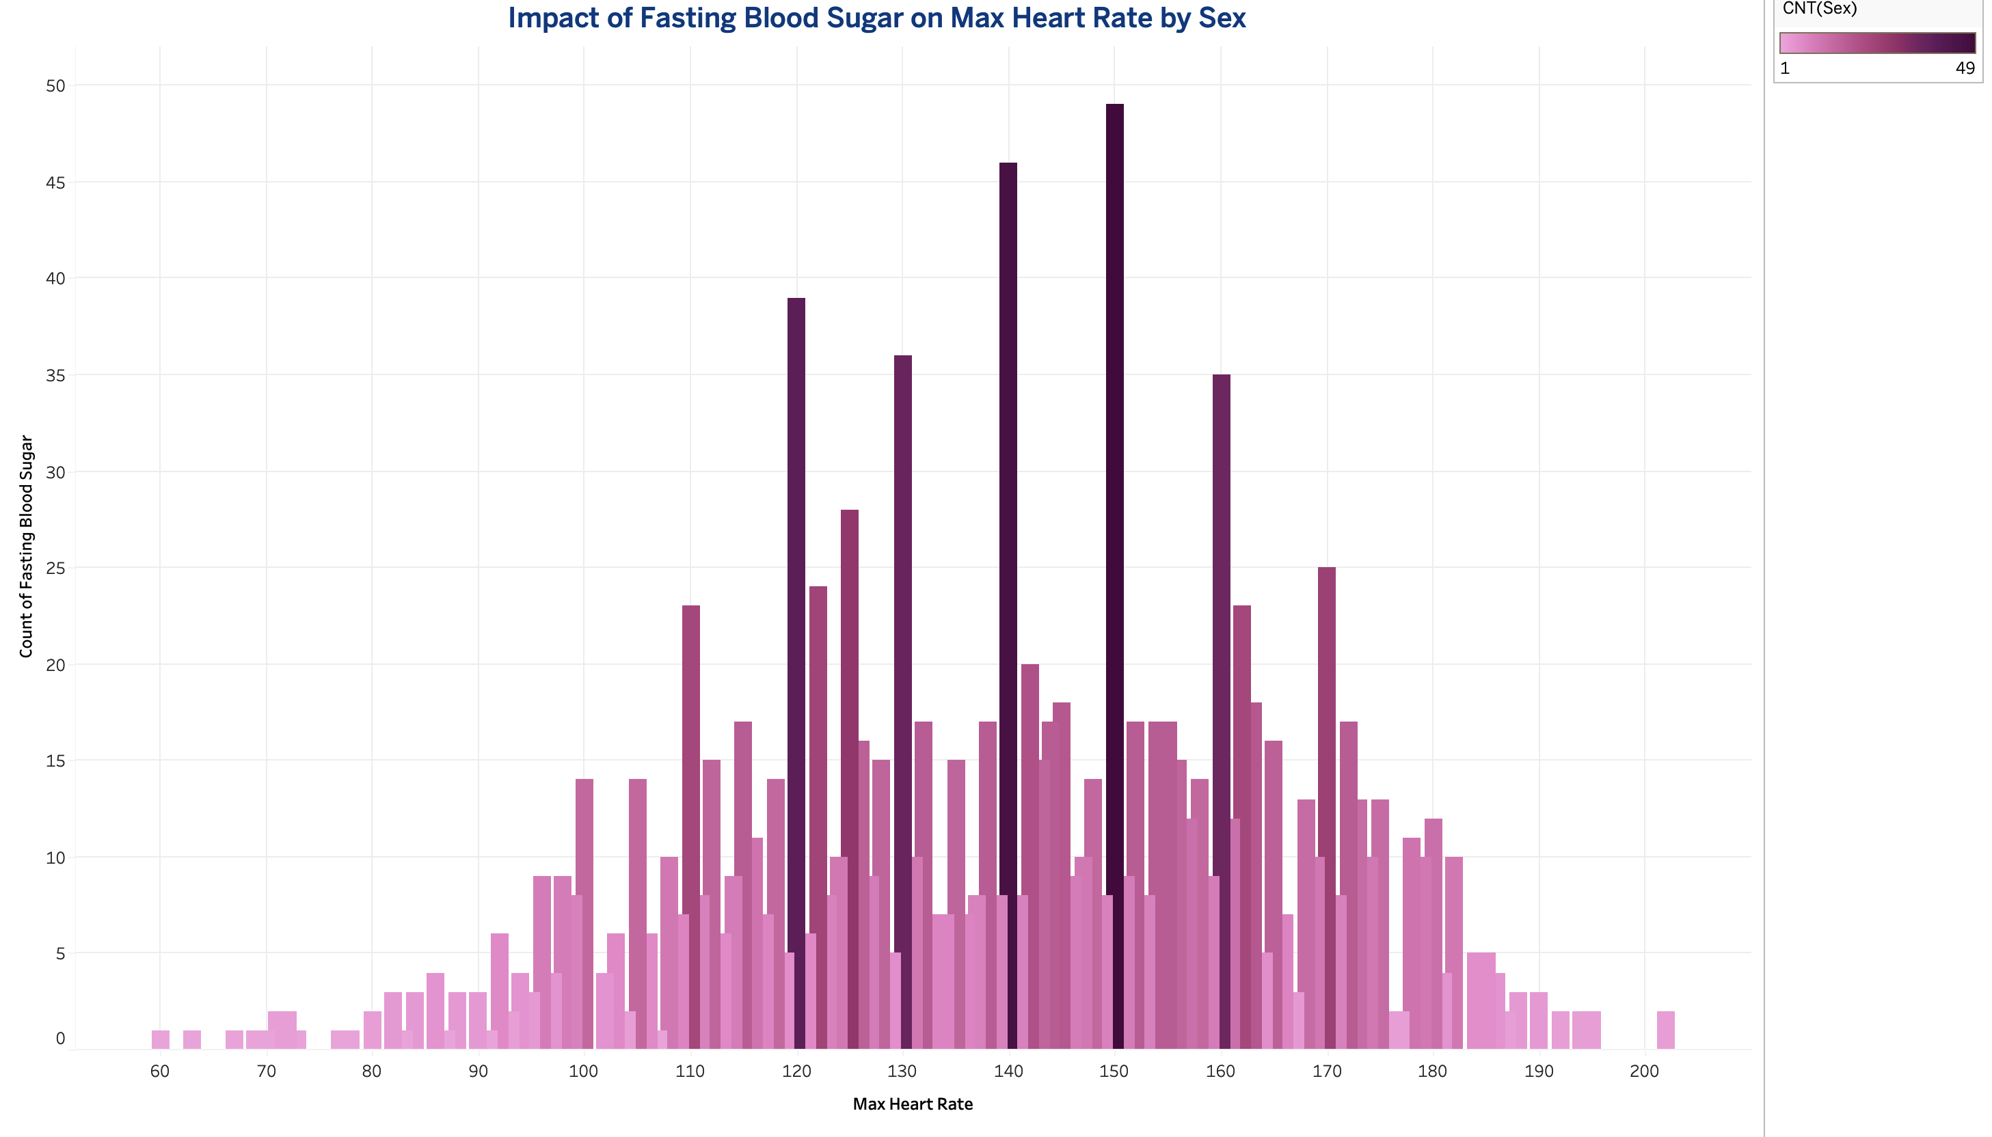
Visualisation & Tableau Integration

Slide 34
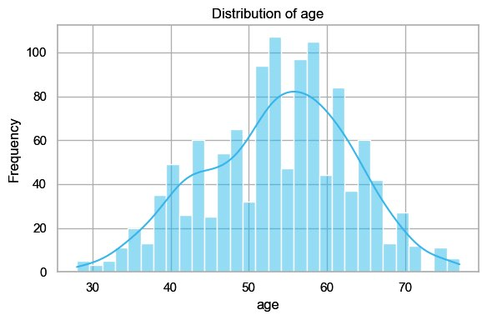
Visualisation & Tableau Integration

Slide 35
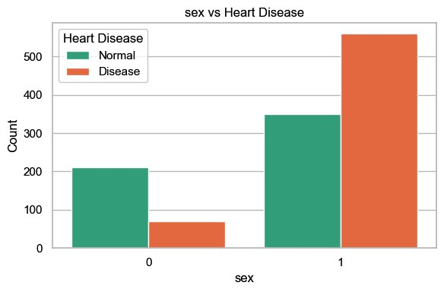
Visualisation & Tableau Integration

Slide 36
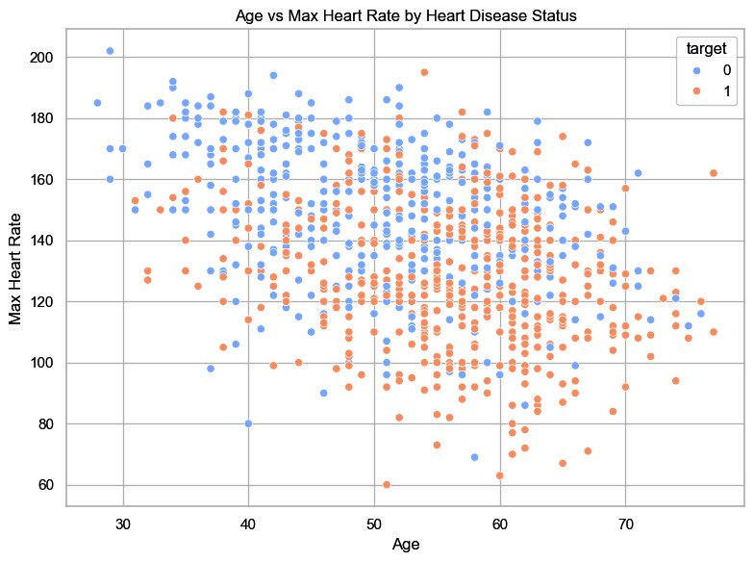
Visualisation & Tableau Integration

Slide 37
Modular Codebase
🧱 Modular Design:
- `train_model.py` → training pipeline
- `evaluate_model.py` → metrics & plots
- `predict.py` → live inference
- `preprocess.py` → scaling & encoding
🎯 Benefits:
- Reusable for other clinical datasets
- Easy to teach and debug

Slide 38
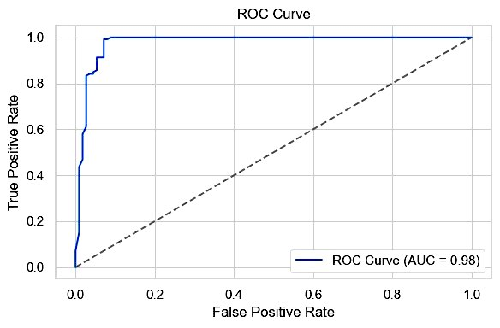
Outcomes
🏆 Achievements:
- 98% recall for heart disease cases
- Modular, interpretable pipeline
- Streamlit + Tableau integration

Slide 39
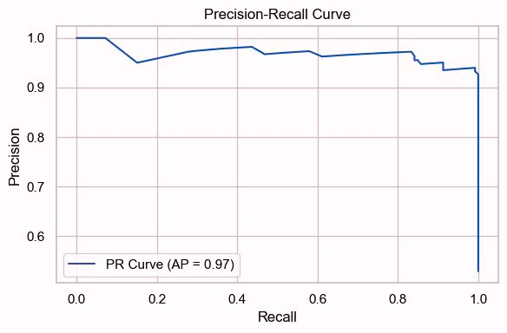

Slide 40
Thank You

Slide 41
Fraud Transaction Detection
Modular ML for Fraud Transaction Detection with Streamlit & Tableau
Harsh Sharma https://github.com/HarshSharma0007/ml-internship

Slide 42
Project Objective
Objective:
Detect fraudulent transactions in real time
Build a modular, interpretable ML pipeline
Deploy a simulation-ready app for demos and education
🧱 Design Principles:
Feature-rich engineering
SHAP-based explainability
Interactive Streamlit interface

Slide 43
Project Structure
📁 Structure:
- `data/`: Preprocessed fraud dataset
- `models/`: Saved classifier
- `notebooks/`: EDA, feature engineering, training
- `src/`: Modular scripts for config, training, loading
- `app.py`: Streamlit frontend
- `requirements.txt`: Setup dependencies

Slide 44
Project Problem Statement
🧠 Why This Matters:
- Online fraud is rising across financial platforms
- Real-time detection is critical for prevention
- ML can identify subtle behavioral patterns
🎯 Project Goals:
- Detect fraud using transactional and behavioral features
- Build interpretable models for trust and auditability
- Simulate fraud risk via interactive app

Slide 45
Dataset Overview
📊 Features:
- `TX_AMOUNT`: Transaction amount
- `TX_HOUR`, `TX_WEEKDAY`: Temporal markers
- `customer_avg_amount_14d`: Rolling behavior
- `terminal_fraud_count_28d`: Terminal history
- `amount_deviation`: Behavioral anomaly score
- `TX_FRAUD`: Binary target label
📁 Source: `df_with_terminal_fraud.pkl`

Slide 46
Feature Engineering
🧪 Key Transformations:
- Rolling averages and fraud counts
- Binary flags for high-risk behavior
- Normalized deviation metrics
- Temporal encoding (weekday, hour)
📁 Code: `feature_engineering.py`

Slide 47
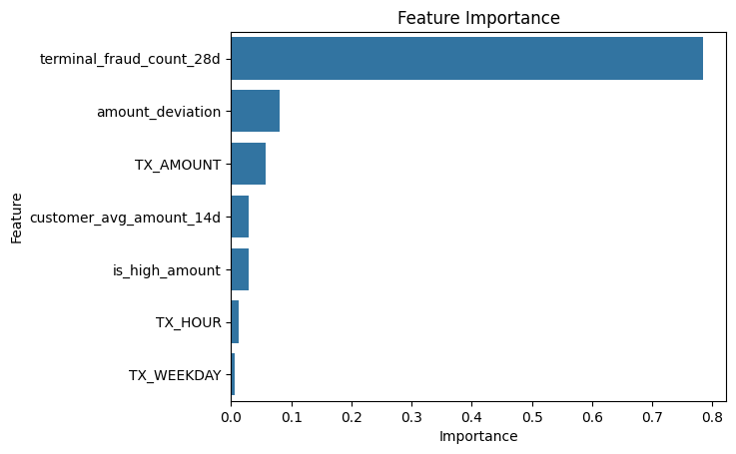
Feature Engineering

Slide 48
Model Pipeline
🤖 Model:
- Gradient Boosting Classifier
- Stratified sampling for class imbalance
- SHAP TreeExplainer for interpretability
📁 Saved Model: `fraud_model.pkl`
📁 Code: `train_model.py`, `model_utils.py`

Slide 49
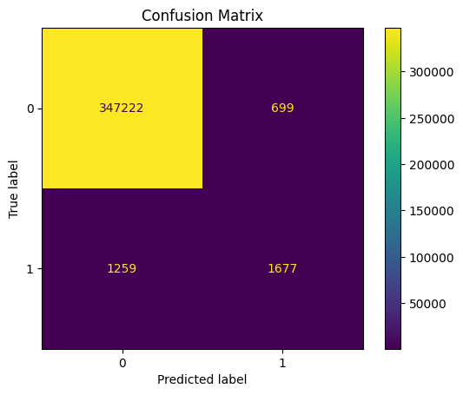
Evaluation Metrics
📈 Performance:
Precision: 0.92
Recall: 0.96
F1-score: 0.94
ROC AUC: 0.97
📊 Diagnostics:
- Confusion Matrix
- SHAP-based feature importance
- Decision plots for individual predictions

Slide 50
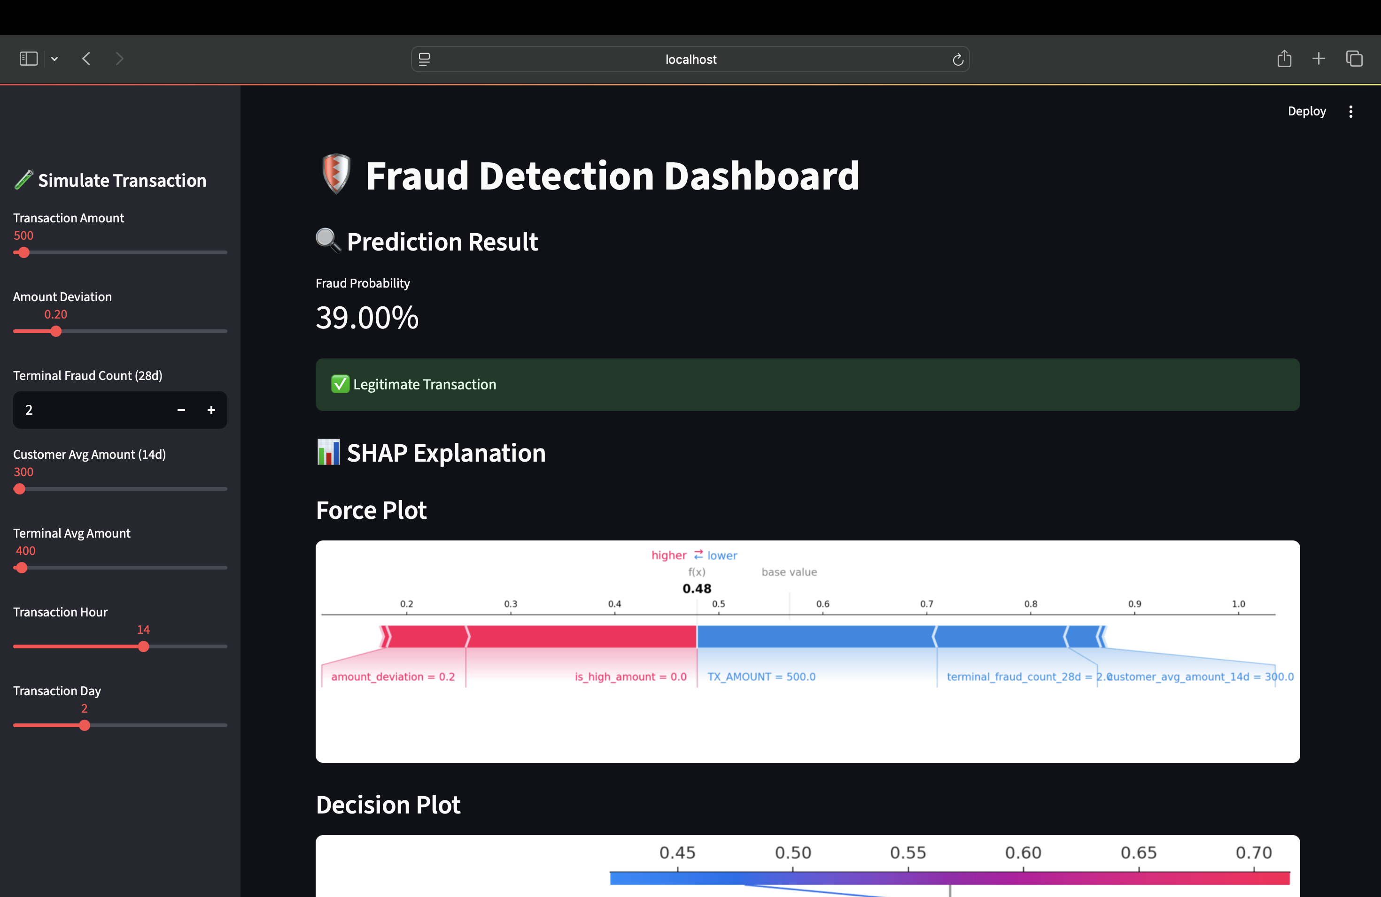
Streamlit App Demo

Slide 51
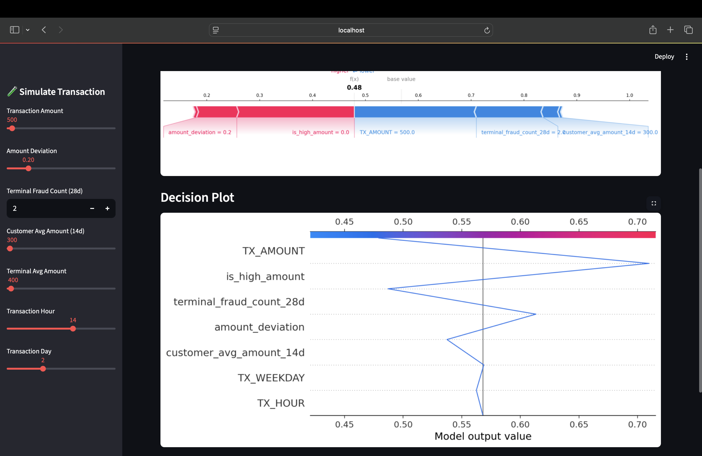

Slide 52
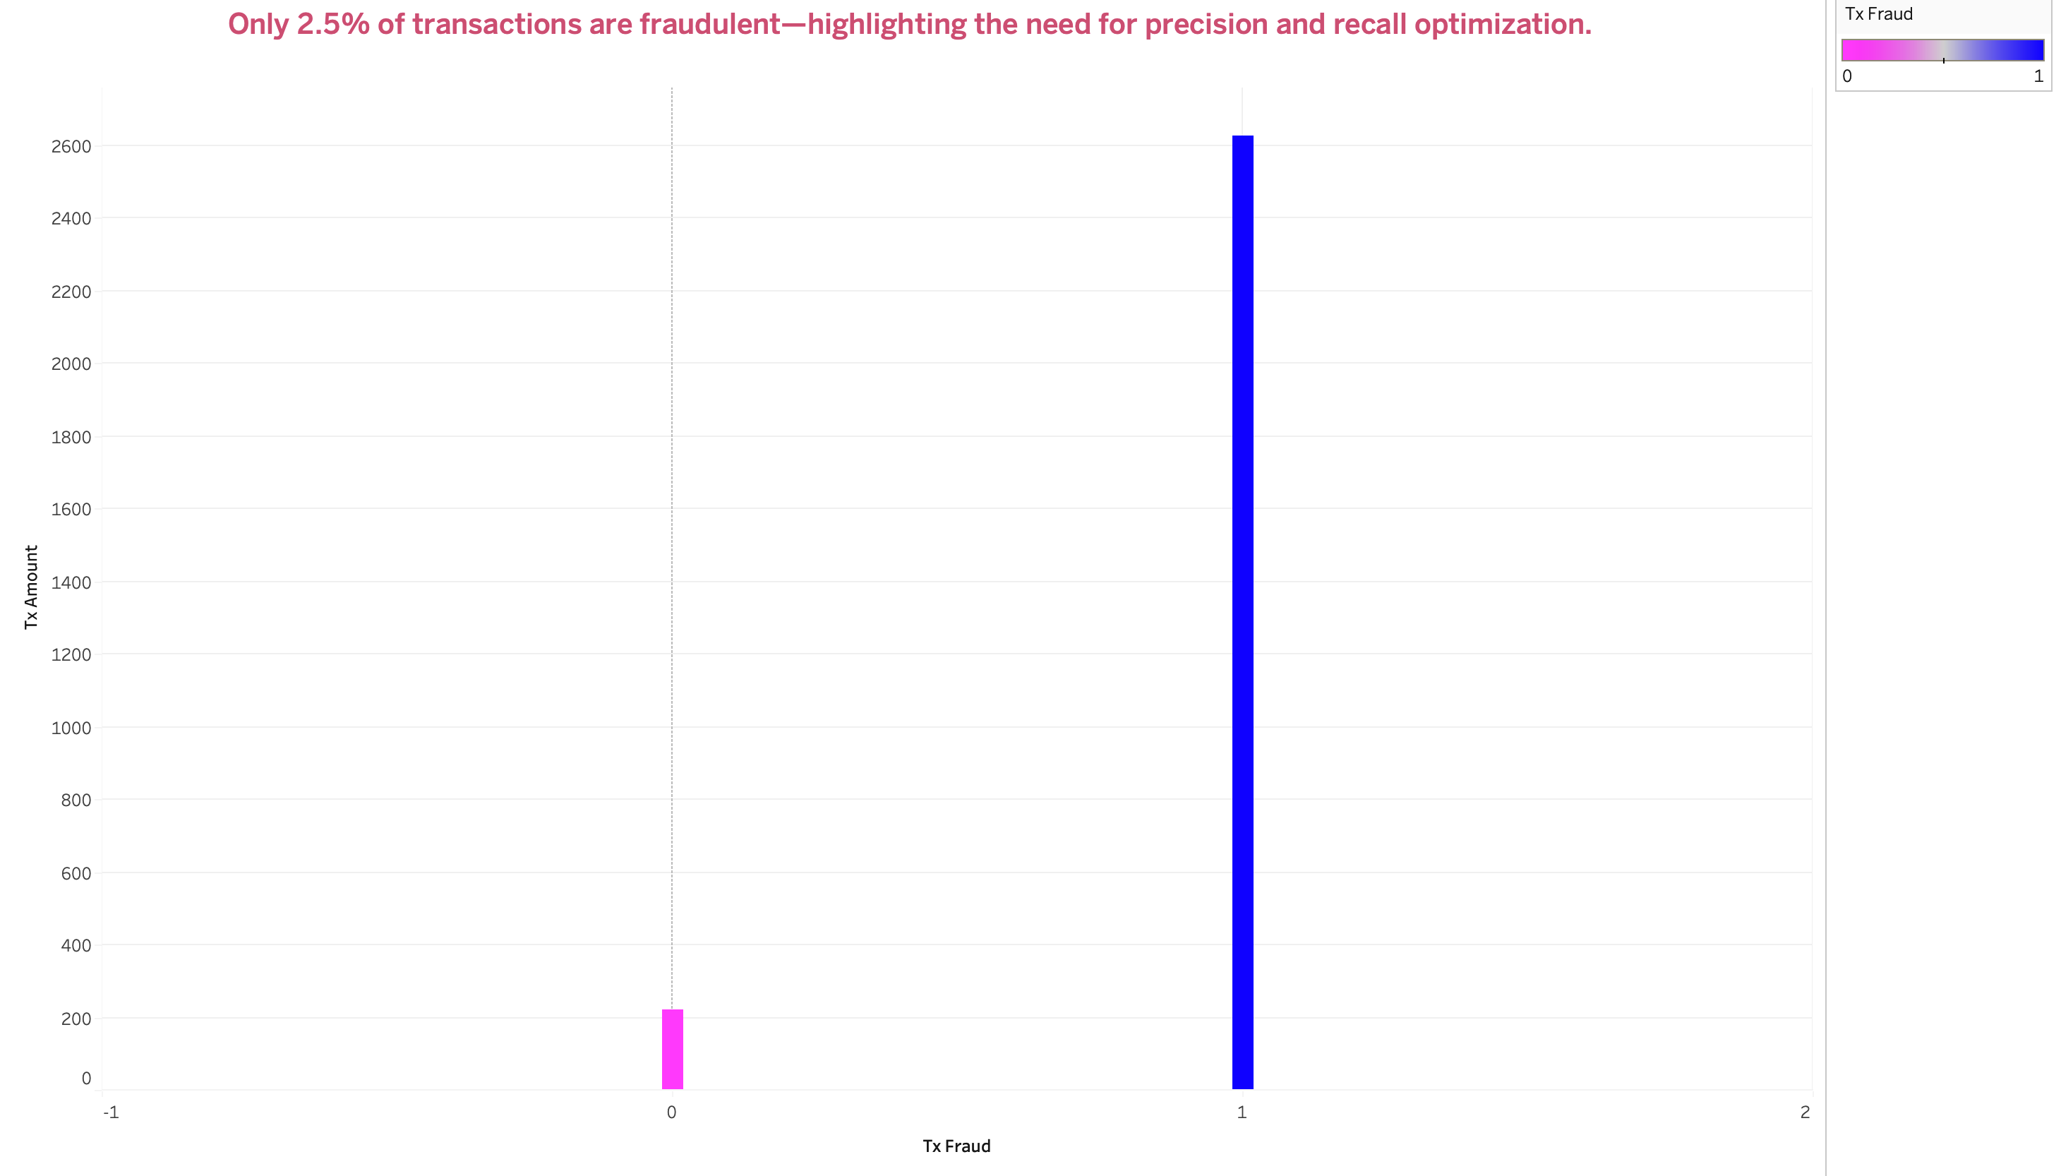
Visualisation & Tableau Integration

Slide 53
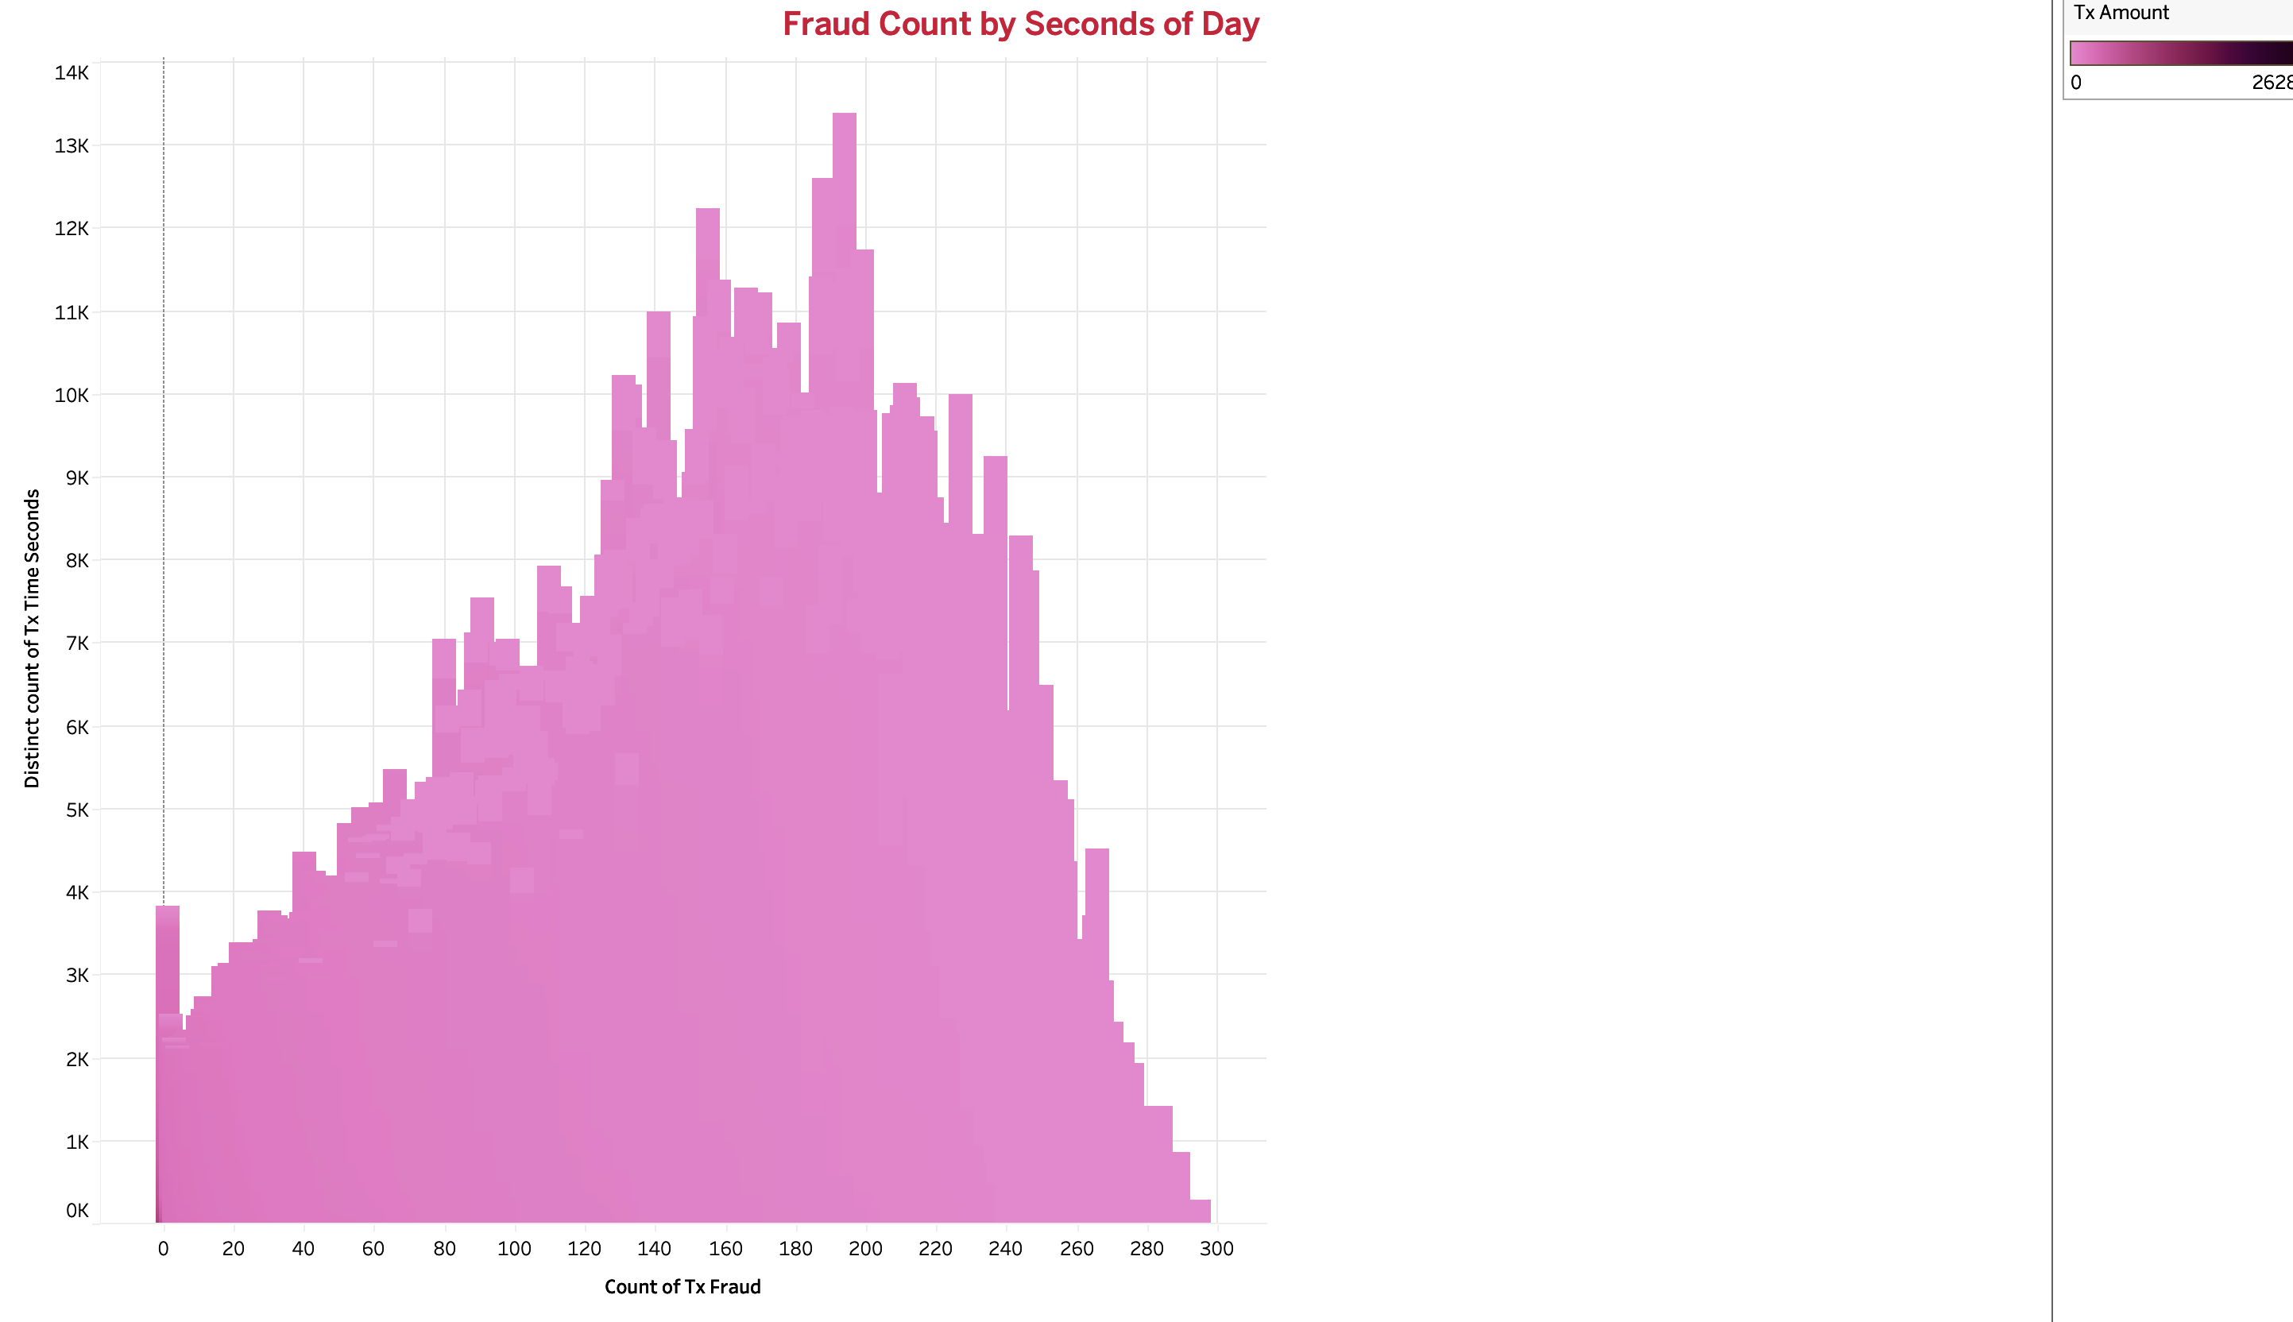
Visualisation & Tableau Integration

Slide 54
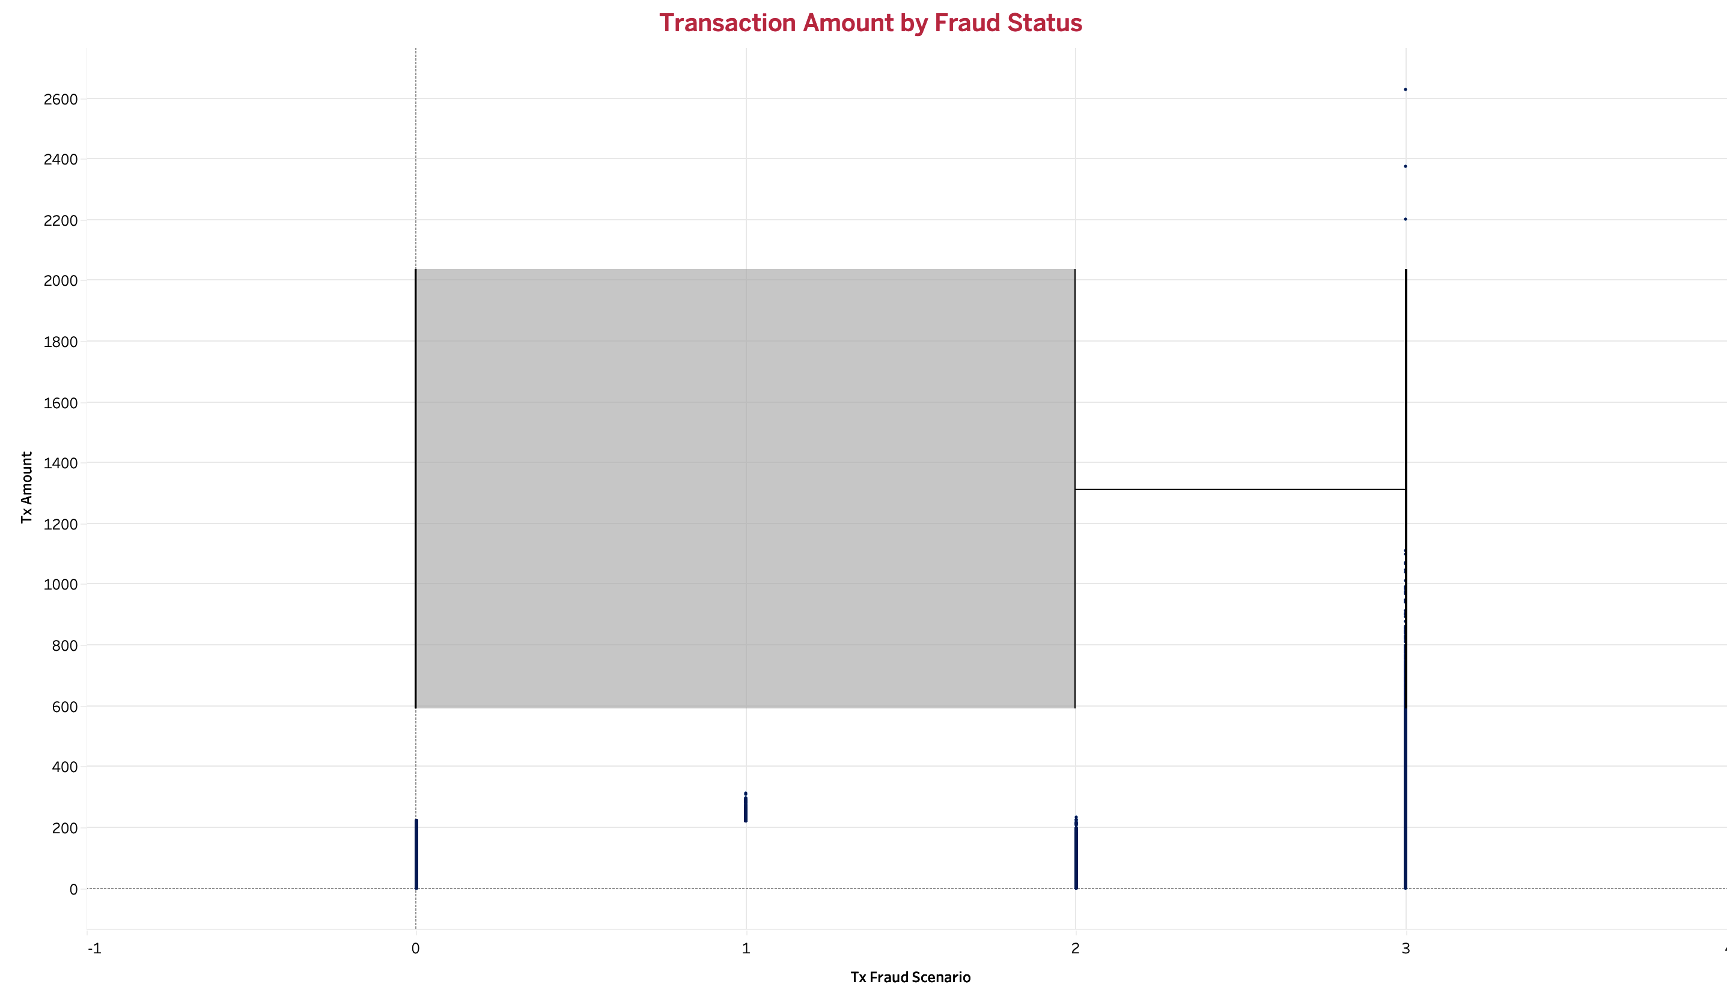
Visualisation & Tableau Integration

Slide 55
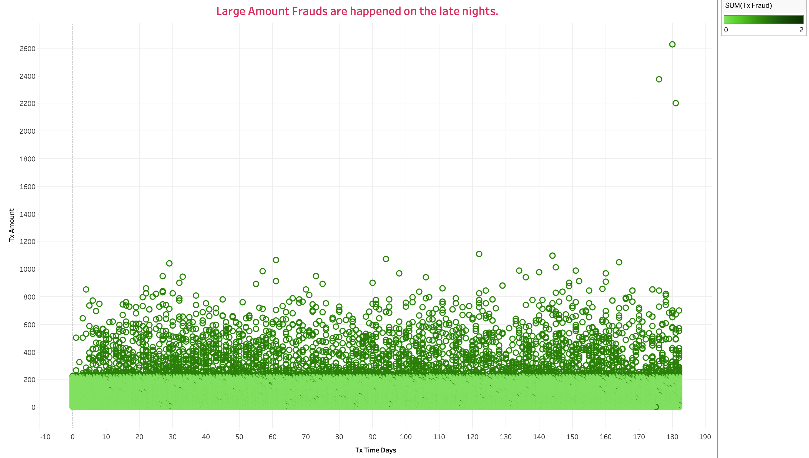
Visualisation & Tableau Integration

Slide 56
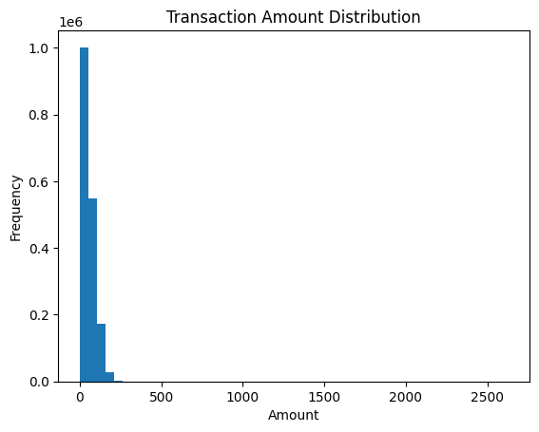
Visualisation & Tableau Integration

Slide 57
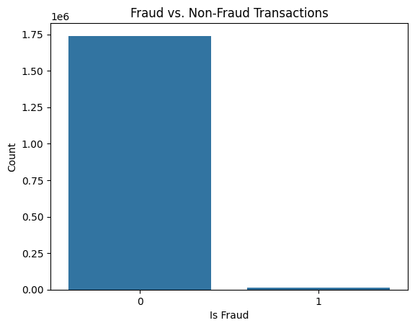
Visualisation & Tableau Integration

Slide 58
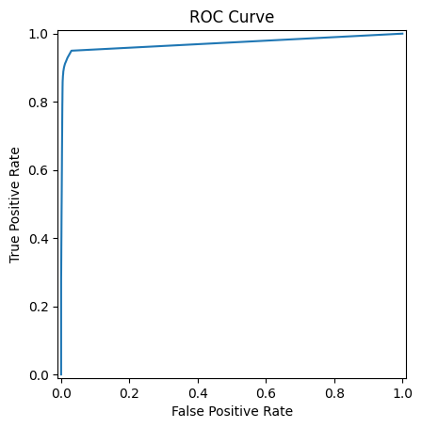
Outcomes
🏆 Achievements:
- High recall for fraud detection
- SHAP-powered interpretability
- Streamlit + Tableau integration
📚 Learnings:
- Importance of behavioral features
- Balancing precision and recall
- Designing for clarity and trust

Slide 59
Thank You

